Slide 1
Polarisation
Only transverse waves can be polarised. Therefore, the fact that light waves can be polarised is a proof that EM waves are transverse in nature.

Slide 2
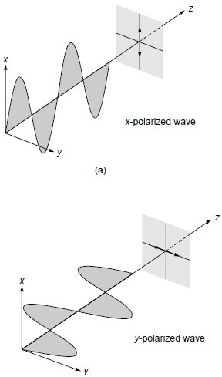
Imagine a rope and you are moving it in xz plane and then
in yz plane.
It can be related to plane polarised light in x- direction if Electric filed is oscillating in xz plane

Slide 3
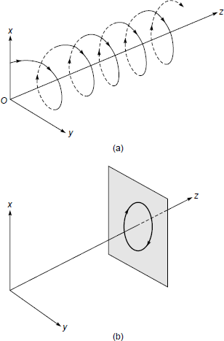
What if you start moving this rope in a circle.
It can be related to circularly polarised light .

Slide 4
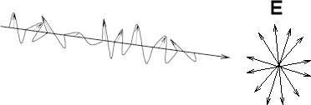
What if you start moving rope in random directions in short interval of time?
It can be related to unpolarised light.

Slide 5
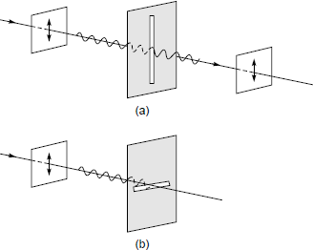
What if you introduce a slit in the path?
If a longitudinal wave were propagating in string, amplitude of transmitted wave would have been same for all orientations.

Slide 6
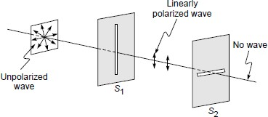

Slide 7
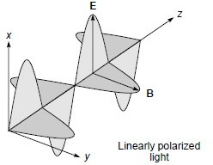
Electromagnetic Waves :
The direction of polarisation of an electromagnetic wave has traditionally been defined to lie along the direction of oscillation of the electric field.

Slide 8
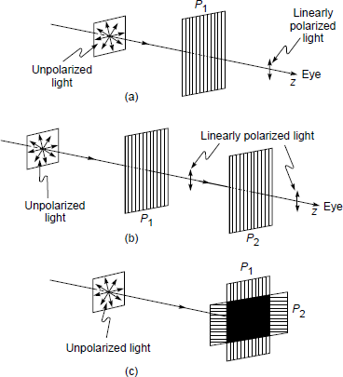
P1 and P2 are polaroids.
If P1 and P2 are parallel to each other, light intensity will be maximum
after P2.
If P1 and P2 are perpendicular to each other, light intensity is minimum after P2.

Slide 9
Representation of unpolarised light:
Electric field
vector is decomposed into 2 perpendicular
components. If direction of propagation of wave is z-direction, then Electric field vector is decomposed into x and y components.
For unpolarised light, the components have equal amplitudes, and the phase difference between them varies randomly.

Slide 10
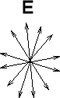









Direction of propagation
If E is represented in x and y direction:
Direction of propagation
Represents component out of plane Represents component in the plane

Slide 11
Production of Linearly Polarised light:
The wire grid polariser
The Polaroid.
Polarisation by reflection.
Polarisation by double refraction.

Slide 12
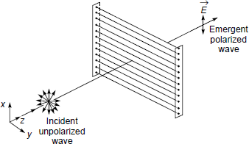
The wire grid polariser :

Slide 13
Very thin Copper wires placed parallel to each other.
When an unpolarised light is incident on it, component of electric vector along the length of the wire is absorbed. Because electrons in wire start moving in electric field and energy associated with electric field is lost in Joule heating of wires.
Since wires are very thin electric field component along the x-axis passes through without much attenuation because electrons don't have much space to move.
Therefore, outgoing wave is linearly polarised with electric vector in x-direction.

Slide 14
It will work ( Ey will be almost completely attentuated) if the spacing between is ≤λ.
Therefore, this polariser is easy to fabricate for a 3cm microwave because spacing needed between wires ≤3 cm.
Visible light waves have small wavelength (5 × 10⁻⁵ cm), fabricating a polariser with wire spacing ≤ 5 × 10⁻⁵ cm is very difficult. A polaroid is used for this.

Slide 15
Polaroids:
Instead of Cu wires, long chain polymer molecules that contain atoms (such as iodine) which provide high conductivity along the length of the chain.
These long chain molecules are aligned so that they are almost parallel to one another.
Because of the high conductivity provided by the iodine atoms, the electric field parallel to the molecules gets absorbed.
A sheet containing such long chain polymer molecules (which are aligned parallel to one another) is known as a Polaroid.

Slide 16
When a light beam is incident on such a Polaroid, the molecules (aligned parallel to one another) absorb the component of electric field which is parallel to the direction of alignment because of the high conductivity provided by the iodine atoms; the component perpendicular to it passes through.
Thus the aligned conducting molecules act similar to the wires in the wire grid polarizer, and since the spacing between two adjacent long chain molecules is small compared to the optical wavelength, the Polaroid is usually very effective in producing linearly polarized light

Slide 17
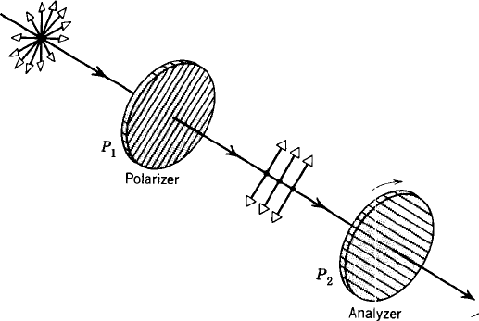
The lines show the direction of polarisation.
If you start rotating the analyser, at 90º and 270º, the transmitted intensity will be minimum.
The transmitted intensity will be maximum when analyser is at angle of 0º and 180º.

Slide 18
Polarisation by Reflection:
Brewster discovered that there is a particular angle of incidence at which, if unpolarised light is incident on glass or dielectric material, the reflected light is polarised.
This particular angle of incidence is also known as
Brewster angle and is given by :
n₂
−1
θ=θ =tan ( _{n} )
p
1
Using a polaroid, reflected light can be checked for polarisation. Intensity of reflected light should be zero twice in one complete rotation.

Slide 19
If an unpolarized light is incident at Brewster angle, then the reflected beam will be linearly polarized with its electric vector perpendicular to the plane of incidence.
Reflected
Unpolarized light
polarized light
θ
p
θ
p
Air
Glass
θ
r

Slide 20









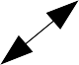
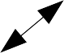
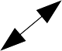
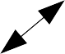
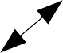
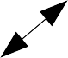
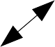
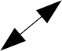
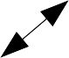
If an wave polarised in plane of paper is incident at Brewster angle, then there will be no reflected beam!
polarized wave
No reflected wave
θ
p
Air
Glass
θ
r

Slide 21
Brewster angle is given by :
n₂
−1
θ =tan ( _{n} )
p
1
If wave is incident from air to glass, n = 1. Therfore,
1
θ_{p}=tan⁻ (n₂)⇒ tan (θ_{p} )=n₂
1
sin(θ_{p}) _{=n}
cos(θ )
2
p
sin(θ_{p} )_{=n}
Applying Snell's law :
sin (θ )
2
r
sin (θ _{p})₌ sin (θ _{p})
sin (θ_{r} ) cos(θ_{p})
From both of these equations:
⇒ sin(θ_{r} )=cos(θ_{p} )
⇒ sin(θ_{r} )=sin (90 −(θ_{p}))
o o
⇒θ_{r} =90 −θ_{p} ⇒ θ_{r} +θ_{p}=90
o

Slide 22
Reflected polarized light
Unpolarized light
θ
p
θ
p
Air
90º
Glass
θ
r

Slide 23
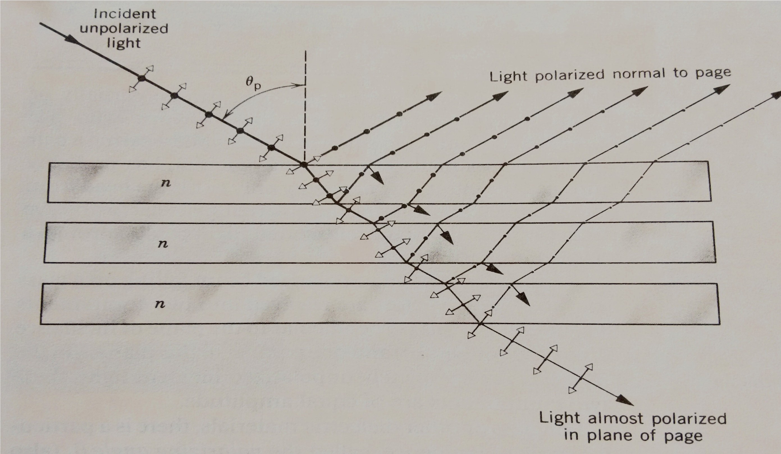
Intensity of reflected polarised light can be increased by using a pile of plates.

Slide 24
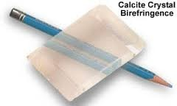
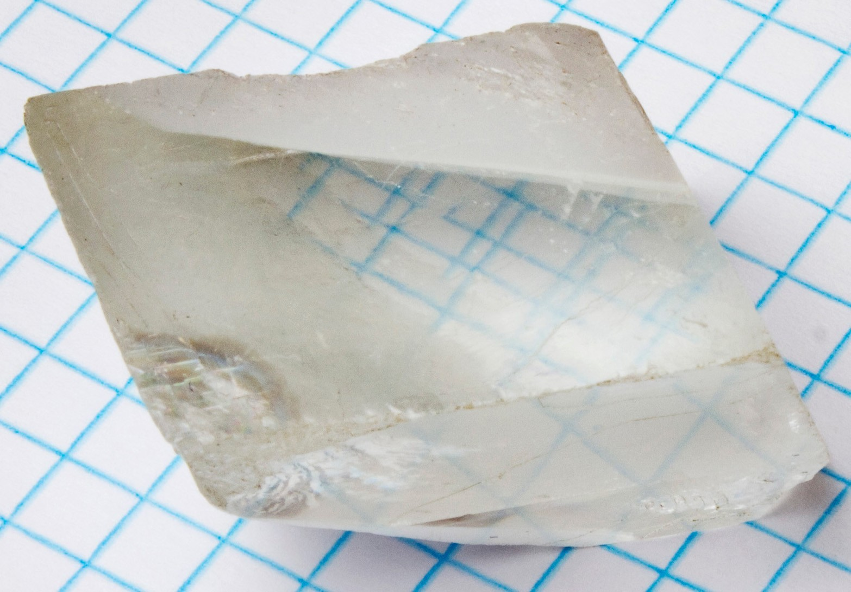
Polarisation by double refraction :
If beam of light is passed through certain crystal like calcite (CaCO ) or quartz (SiO ), it splits into two beams.
3 2
These substances are called doubly refracting or
birefringent.

Slide 25
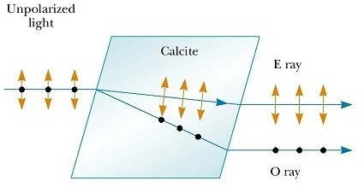
One of refracted beams obeys Snell's law and is called Ordinary ray (O-ray). The other beam doesn't obey Snell's law and is called Extraordinary ray (E-ray).

Slide 26
The E-ray travels in the crystal with a speed that varies with direction and is described by ellipsoid. The O-ray travels in the crystal with a constant speed in all direction and is described by spheroid.
The refractive index for O-rays is constant and is direction dependent for E-rays.
In the case of Calcite and Quartz crystal, there is one direction in which there is no double refraction. This direction is called optic axis or principal axis. There are also biaxial crystals, no double refraction occurs in two specific directions.
O-rays and E-rays are polarised in a
direction perpendicular to each other. O-rays are polarised
perpendicular to plane containing optical axis.

Slide 27
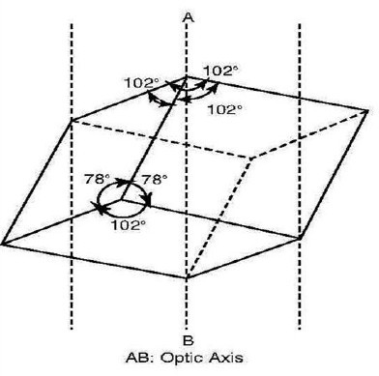
The optic axis of a calcite crystal denoted by dotted line AB. Any ray of ordinary unpolarised light incident along the optic axis or parallel to this axis does not split up into two rays.

Slide 28
The plane containing the optic axis and the perpendicular to the pair of opposite faces of the crystal is known as principal section for that pair of faces of the crystal.
Since the crystal has six faces, for each pair of opposite faces of the crystal, there are three principal sections.

Slide 29
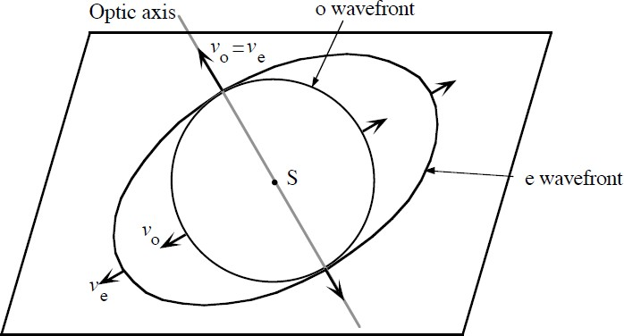
Wavefront of O- and E-rays :
S is the point from where light is starting at same time in double refracting crystal.

Slide 30
For negative uniaxial crystals (like calcite) in which the velocity of O-ray is less than the velocity of E-ray, sphere lies inside the ellipsoid. However, for positive uniaxial crystals (like quartz) the ellipsoid lies inside the sphere since in this case the velocity of O-ray is greater than the velocity of E-ray.
o wavefront
Optic axis
e wavefront
S
V
e
V
V <V
o e
Negative crystal
o
V > V
o e
Positive crystal

Slide 31
Nicol Prism : Based on double refraction
Nicol prism is an optical device which is used for producing and analyzing plane polarized light in practice.
Calcite crystal is cut along a diagonal and cemented back together with special cement called Canada balsam.
μ = 1.65836, μ = 1.55, μ = 1.48641
o canada balsam e
Birefringence (B) = |μ - μ |
e o
where μ and μ are the refractive indices experienced by
e o
the extraordinary and ordinary rays, respectively.

Slide 32
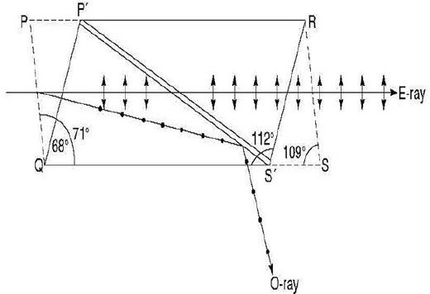
Length three times of its width
Its end faces PQ and RS are cut such that the angles in the principal section become 68° and 112° in place of 71° and 109° ( naturally occurring crystal).

Slide 33
Working of Nicol Prism :
When a beam of unpolarised light is incident on the face P′Q, it gets split into O-ray and E-ray.
These two rays are plane polarised rays, whose vibrations are at right angles to each other. The refractive index of Canada balsam cement being 1.55 lies between those of ordinary and extraordinary (1.65836 and 1.4864, respectively).
Canada Balsam layer acts as an optically rarer medium for the ordinary ray and it acts as an optically denser medium for the extraordinary ray.

Slide 34
When ordinary ray of light travels in the calcite crystal and enters the Canada balsam cement layer, it passes from denser to rarer medium. Moreover, the angle of incidence is greater than the critical angle, the incident ray is totally internally reflected from the crystal and only extraordinary ray is transmitted through the prism.
Therefore, fully plane polarised wave is generated with the help of Nicol prism.

Slide 35
Nicol Prism as a Polariser and an Analyser :
In order to produce and analyse the plane polarised light, two nicol prisms are arranged.
When a beam of unpolarised light is incident on the nicol prism, emergent beam from the prism is obtained as plane polarised, and which has vibrations parallel to the principal Section.
This prism is therefore known as polariser. If this polarised beam falls on another parallel nicol prism P2, whose principal section is parallel to that of P1, then the incident beam will behave as E-ray inside the nicol prism P2 and gets completely transmitted through it.
This way the intensity of emergent light will be maximum.

Slide 36
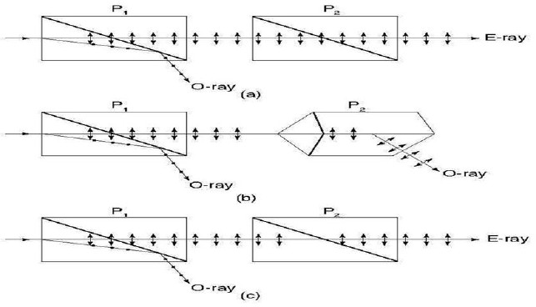

Slide 37
Now the nicol prism P2 is rotated about its axis, then we note that the intensity of emerging light decreases and becomes zero at 90° rotation of the second prism (Fig. b).
In this position, the vibrations of E-ray become perpendicular to the principal section of the analyser (nicol prism P2).
Hence, this ray behaves as O-ray for prism P2 and it is totally internally reflected by Canada balsam layer. This fact can be used for detecting the plane polarised light and the nicol prism P2 acts as an analyser.
If the nicol prism P2 is further rotated about its axis, the intensity of the light emerging from it increases and becomes maximum for the position when principal section of P2 is again parallel to that of P1 (Fig. c). Hence, the nicol prisms P1 and P2 acts as polariser and analyser, respectively.

Slide 38
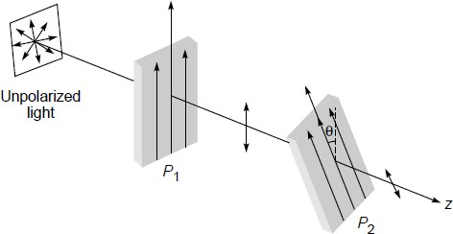
Malus' law :
y
polarizer P which has a pass axis parallel to the y axis;
1
i.e., if an unpolarized beam propagating in the z direction is incident on the polarizer, then the electric vector associated with the emergent wave will oscillate along the y axis.

Slide 39
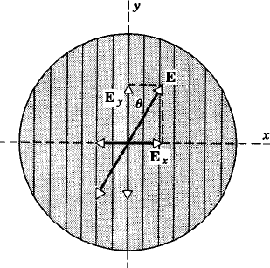
Consider the incidence of the y-polarized beam on the Polaroid P whose pass axis makes an angle θ with the y
2
axis. If the amplitude of the incident electric field is E , then the amplitude of the wave emerging from the Polaroid P
2
will be E cos(θ),
Only E will be transmitted, E
y x
will be absrobed.
E =E cosθ
y 0
Remember lines here show direction of polarisation not wire grid or chain molecules direction. Here, wire grid or chain molecules are aligned along x-axis.

Slide 40
The intensity of the emerging beam will be given by
I = I cos²(θ) Malus' law
0
where I represents the intensity of the emergent beam
0
when the pass axis of P is also along the x axis (i.e., when
2
θ = 0).

Slide 41
Anti-glare automobile headlights :
45º
Two approaching vehicles
Head light
The transmission or pass axis shown by lines in head light and wind screen are perpendicular to each other.
45º
No light from the head light will pass through the
Wind screen.
Wind screen

Slide 42
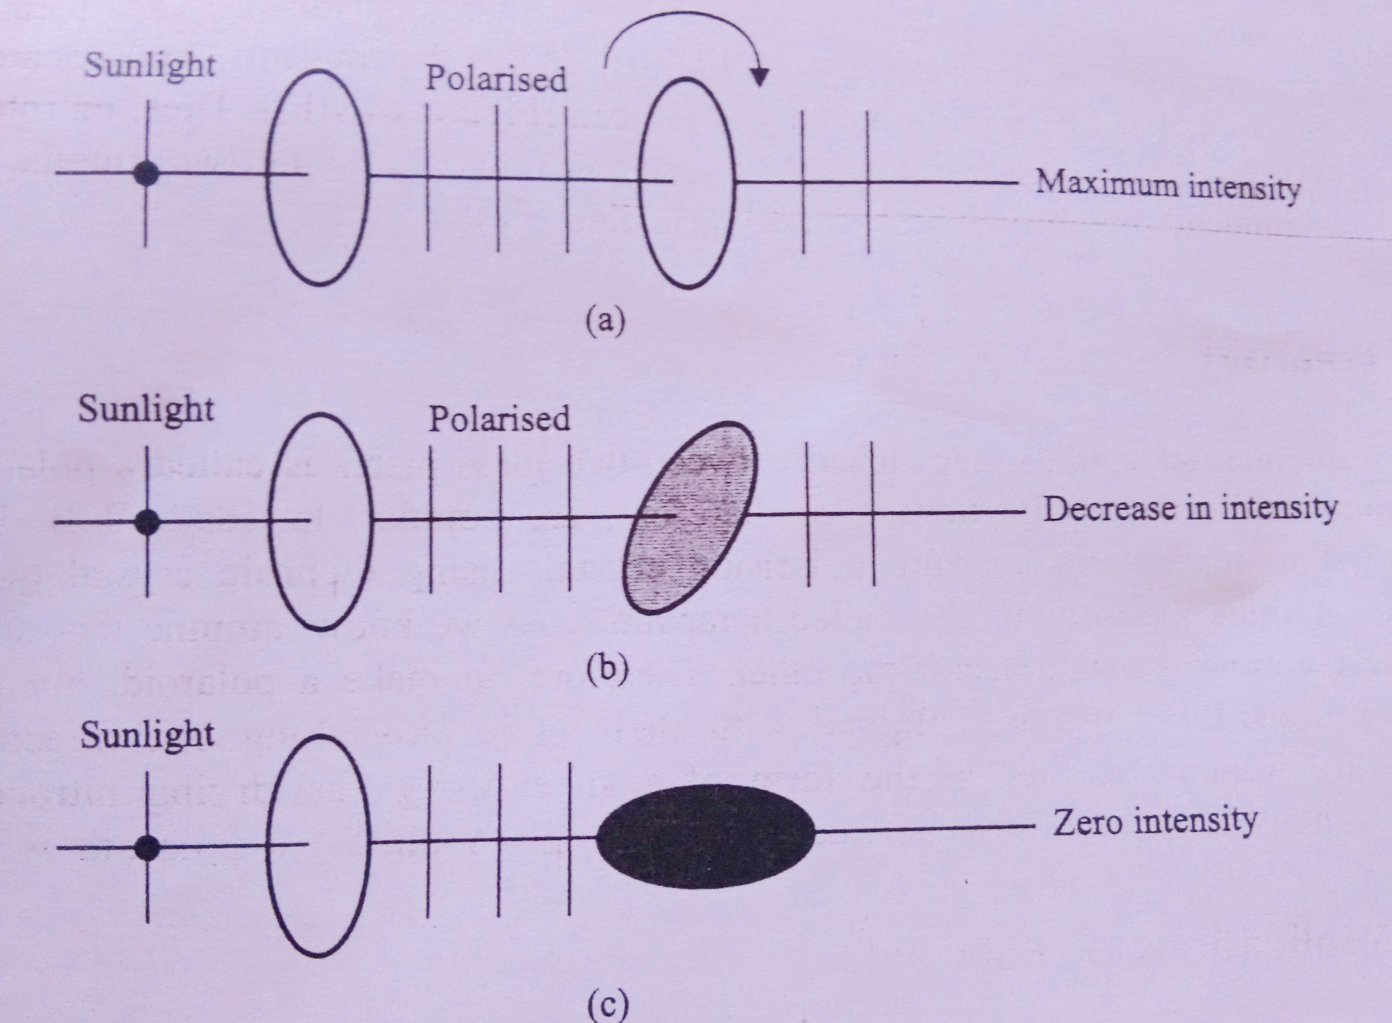
Adjustable tint windows :
By adjusting relative orientation of 2 polaroids, the light intensity is adjusted in tint windows.

